Slide 1
Instructions for Presentation of Introduction to TES Procedures
Please use this slide deck from a TES training in Angola as a template for presenting TES procedures to your in-country TES team.
There are additional instructions in the notes for each slide.

Slide 2


Efficacy and Safety of Artemether-Lumefantrine, Artesunate-Amodiaquine, and Dihydroartemisinin-Piperaquine in the Treatment of Uncomplicated Cases of Plasmodium falciparum Malaria in Three Provinces of Angola
MINISTRY OF HEALTH
NATIONAL DIRECTORATE OF PUBLIC HEALTH
NATIONAL MALARIA CONTROL PROGRAMME

Slide 3


Malaria is a major cause of illness and death in the country
3,800,000 cases
Notes:
Insert a figure demonstrating the number of malaria cases your country experiences each year

Slide 4
Malaria is a major cause of illness and death in the country
3,800,000 cases
8,000 deaths
Notes:
Insert a figure demonstrating the number of malaria deaths your country experiences each year

Slide 5
Malaria is a major cause of illness and death in the country
3,800,000 cases
8,000 deaths
35% of demand
Notes:
What % of demand for medical care do malaria cases take up?

Slide 6
Malaria is a major cause of illness and death in the country
3,800,000 cases
8,000 deaths
35% of demand
60% of admissions
Notes:
What % of hospital admissions in children under 5 years of age are due to malaria?
MIS 2016
DHS 2017
Anitta to send email to NMCP M&E

Slide 7
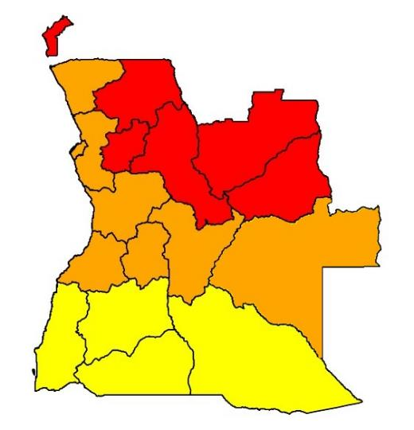
Malaria Epidemiology 3 zones
3 endemic zones
Hyperendemic
Mesoendemic unstable
Mesoendemic stable
Notes:
Use this slide to share a map of your country with the various levels of transmission plotted on the map
Hyperendemic = parasitemia >50% in children <5 years of age.
Mesoendemic = parasitemia of between 10 and 20% in children <5 years.
Stable = little variation in transmission level from year to year (population with high immunity = less severe symptoms).
Unstable = transmission varies each year (population with low immunity = more severe symptoms)
Prevalence map*** SL

Slide 8

Fight against Malaria
Notes:
One way to fight against malaria is mosquito netws

Slide 9
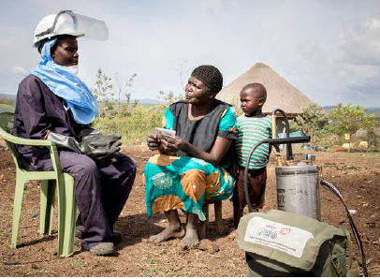
Fight against Malaria
Notes:
Another is Indoor Residual Spraying

Slide 10

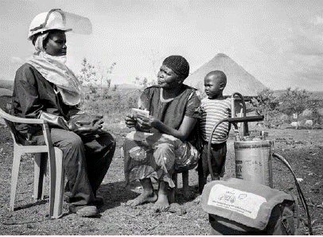
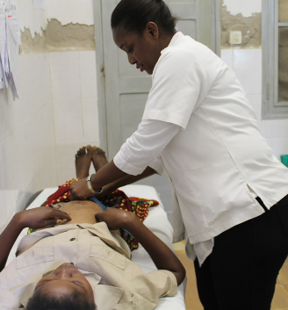
Fight against Malaria
Notes:
Another important aspect in the fight against malaria is preventing malaria in pregnant women

Slide 11
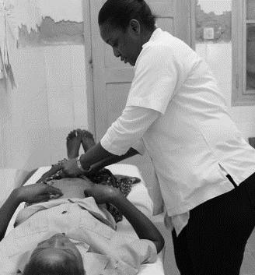
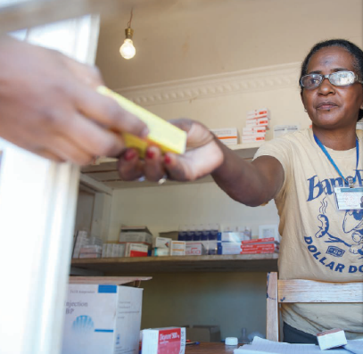
Fight against Malaria
Notes:
When we cannot prevent malaria, the most important response in the fight against malaria is appropriate malaria case management
1. Diagnosis (TDR or microscopy)
2. Treatment with effective antimalarials (Artemisinin-based Combination Therapy - ACT)

Slide 12
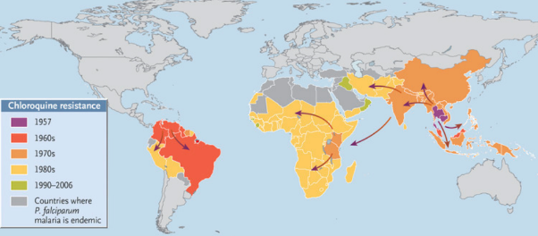
Antimalarial Drug Resistance
One of the biggest challenges in malaria control
Parasite usually develops resistance to antimalarial drugs soon after their introduction
Chloroquine
Sulfadoxine-Pyrimethamine
Artemisinin resistance (ACT's)
Notes:
Single-drug therapy developed resistance rapidly
Combination treatment with artemisinin is now used

Slide 13
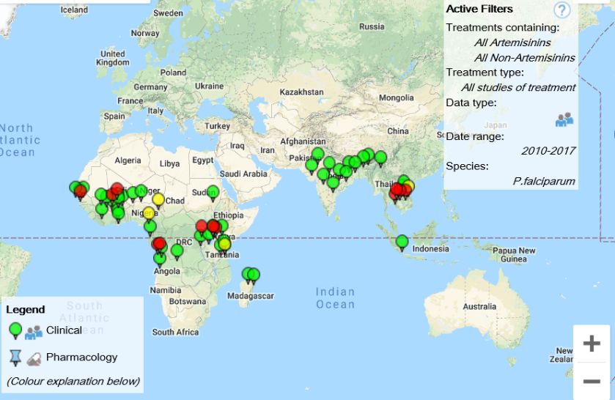
Surveillance of Resistance

Slide 14

Rigorous Study
Therapeutic efficacy studies
Standard protocol
Every 2 years
Notes:
Standard protocol
No room for improvisation

Slide 15
TES: General objective
To monitor the efficacy and safety of three antimalarial drugs in the treatment of uncomplicated malaria cases in Angola
Notes:
Edit this slide so that the number of sites and number of drugs are relevant to your country’s TES

Slide 16
Specific Objectives
Determine the level of antimalarial therapeutic efficacy
Determine the level of parasitological response
Confirm that the drugs recommended in the treatment guidelines drug policy of the National Malaria Control Programme continue to be effective
Asses the rate of adverse effects
Determine polymorphisms in molecular markers of antimalarial drug resistance

Slide 17
Study Design
Study population
children with malaria

Slide 18
Study Design
Study population
children with malaria
Medical intervention
1 of 3 ACTs recommended by NMCP
Notes:
Change this slide so that it reflects the number of ACTs currently recommended by your country’s NMCP

Slide 19
Study Design
Study population
children with malaria
Medical intervention
1 of 3 ACTs recommended by PNCM
Clinical follow-up
28 or 42 days depending on treatment

Slide 20
Study Design
Study population
children with malaria
Medical intervention
1 of 3 ACTs recommended by PNCM
Clinical follow-up
28 or 42 days depending on treatment
Outcome of the intervention
therapeutic and parasitological response

Slide 21
Study Sites
3 sites: Benguela, Zaire, and Lunda Sul
Notes:
Change this slide so that it reflects the sites in your country’s current TES

Slide 22
Study Sites
3 provinces: Benguela, Zaire, and Lunda Sul
2 health units per province
Zaire: Municipal Hospital and WCC 11 November
Benguela: General Hospital and Municipal Hospital
Lunda Sul: CS Tchizainga, HM Saurimo
Notes:
Change this slide so that it reflects the sites in your country’s current TES
Change this slide so that it contains the names of the health facilities where the TES will be conducted

Slide 23
Study Sites
3 provinces: Benguela, Zaire, and Lunda Sul
2 health units per province
Zaire: Municipal Hospital and WCC 11 November
Benguela: General Hospital and Municipal Hospital
Lunda Sul: CS Tchizainga, HM Saurimo
1 single species of malaria
Plasmodium falciparum
Notes:
Change this slide so that it reflects the sites in your country’s current TES
Change this slide so that it contains the names of the health facilities where the TES will be conducted

Slide 24
Clinical intervention
3 possible ACTs
Notes:
Change this slide so that it reflects the number of ACTs being assessed in your country’s TES

Slide 25
Clinical intervention
3 possible ACTs
2 ACTs per province
Notes:
3 - Change this slide so that it reflects the number of ACTs being assessed in your country’s TES
2 – change this slide so that it reflects the number of ACTs that will be assessed per province

Slide 26
Clinical intervention
3 possible ACT's
2 ACT's per province
1 ACT per patient
Notes:
3 - Change this slide so that it reflects the number of ACTs being assessed in your country’s TES
2 – change this slide so that it reflects the number of ACTs that will be assessed per province

Slide 27
Clinical intervention
AL - Coartem: Artemether-lumefantrine
ASAQ - Artesunate-amodiaquine
DP - Dihydroartemisinin-piperaquine
Notes:
Include on this slide the drugs that will be assessed during the TES

Slide 28
BENGUELA
ZAIRE
SOUTH LUNDA
DP
ASAQ
DP
AL
AL
ASAQ
AL - Coartem: Artemether-lumefantrine
ASAQ - Artesunate-amodiaquine
DP - Dihydroartemisinin-piperaquine
Notes:
Benguela/Site 1: list the drugs to be assessed at this site

Slide 29
BENGUELA
ZAIRE
SOUTH LUNDA
DP
ASAQ
DP
AL
AL
ASAQ
AL - Coartem: Artemether-lumefantrine
ASAQ - Artesunate-amodiaquine
DP - Dihydroartemisinin-piperaquine
Notes:
Benguela/Site 1: list the drugs to be assessed at this site
Zaire/Site 2: list the drugs to be assessed at this site

Slide 30
BENGUELA
ZAIRE
SOUTH LUNDA
DP
ASAQ
DP
AL
AL
ASAQ
AL - Coartem: Artemether-lumefantrine
ASAQ - Artesunate-amodiaquine
DP - Dihydroartemisinin-piperaquine
Notes:
Benguela/Site 1: list the drugs to be assessed at this site
Zaire/Site 2: list the drugs to be assessed at this site
South Lunda/Site 3: list the drugs to be assessed at this site
If there are more than 3 sites, continue this pattern

Slide 31
Clinical Follow-up
8 visits over 28 days
AL
0 | 1 | 2 | 3 | 7 | 14 | 21 | 28
ASAQ
0 | 1 | 2 | 3 | 7 | 14 | 21 | 28

Slide 32
Clinical Follow-up
8 visits over 28 days
AL
0 | 1 | 2 | 3 | 7 | 14 | 21 | 28
ASAQ
0 | 1 | 2 | 3 | 7 | 14 | 21 | 28
2 days
10 visits over 42 days
DP
0 | 1 | 2 | 3 | 7 | 14 | 21 | 28 | 35 | 42

Slide 33

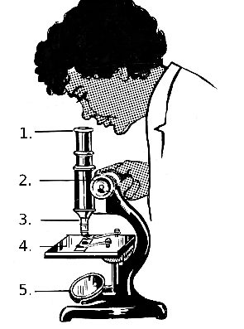
Clinical Follow-up
clinical examinations
laboratory tests

Slide 34
Outcome of the intervention
Therapeutic response - absence of parasitaemia throughout the follow-up period
Side effects of the medicine
Molecular markers

Slide 35
3 Stages of a TES
1st Stage: Screening and enrollment of patients
2nd Stage: Follow-up of patients
3rd Stage: Final patient classification

Slide 36
1st Stage: Screening and enrollment of patients
1
Identify:
"Which patients can be part of the study?"
2
3

Slide 37
1st Stage: Screening and enrollment of patients
1
Identify:
"Which patients can be part of the study?"
Check:
"Of these patients, which ones meet all the inclusion criteria and none of the exclusion criteria?"
2
3

Slide 38
1st Stage: Screening and enrollment of patients
1
Identify:
"Which patients can be part of the study?"
Check:
"Of these patients, which ones meet all the inclusion criteria and none of the exclusion criteria?"
Invite:
"Of these patients, which ones would you agree to be part of the study?"
2
3

Slide 39
2nd Stage: Follow-up visit of the participants
1
Medicines:
"Administer the medicines at the visits on days 0, 1 and 2"
2
3
Notes:
Three main activities
Administration of the drug
Visits on days 0, 1 and 2
Clinical examination with temperature
Each visit
Laboratory tests
Parasitological examination (Each visit except on day 1)
Blood sampling on filter paper (Each visit but not on days 1 and 2)
Haemoglobin test (1 x per week)

Slide 40
2nd Stage: Follow-up of the participants
1
Medicines:
"Administer the medicines at the visits on days 0, 1 and 2"
Clinical examination:
”Conduct an examination of the participants and check their temperature at each visit" and update patients file
2
3
Notes:
Three main activities
Administration of the drug
Visits on days 0, 1 and 2
Clinical examination with temperature
Each visit
Laboratory tests
Parasitological examination (Each visit except on day 1)
Blood sampling on filter paper (Each visit but not on days 1 and 2)
Haemoglobin test (1 x per week)

Slide 41
2nd Stage: Follow-up of the participants
1
Medicines:
"Administer the medicines at the visits on days 0, 1 and 2"
Clinical examination:
”Conduct an examination of the participants and check their temperature at each visit"
Laboratory tests:
"Parasitological and haemoglobin tests and blood collection on filter paper" and write the results in patient's file
2
3
Notes:
Three main activities
Administration of the drug
Visits on days 0, 1 and 2
Clinical examination with temperature
Each visit
Laboratory tests
Parasitological examination (Each visit except on day 1)
Blood sampling on filter paper (Each visit but not on days 1 and 2)
Haemoglobin test (1 x per week)

Slide 42
Health Facility Visit Days
AL
 | 0 | 1 | 2 | 3 | 7 | 14 | 21 | 28 |  |  | Ex
 | 0 | 1 | 2 | 3 | 7 | 14 | 21 | 28 |  |  | Ex
 | 0 | 1 | 2 | 3 | 7 | 14 | 21 | 28 | 35 | 42 | Ex
Treatment
Clinical Examination
Temperature
Parasitemia
Filter paper
Haemoglobin
ASAQ
DP
X

Slide 43
Health Facility Visit Days
AL
 | 0 | 1 | 2 | 3 | 7 | 14 | 21 | 28 |  |  | Ex
 | 0 | 1 | 2 | 3 | 7 | 14 | 21 | 28 |  |  | Ex
 | 0 | 1 | 2 | 3 | 7 | 14 | 21 | 28 | 35 | 42 | Ex
Treatment
Clinical Examination
Temperature
Parasitemia
Filter paper
Haemoglobin
ASAQ
DP
X

Slide 44
Health Facility Visit Days
AL
 | 0 | 1 | 2 | 3 | 7 | 14 | 21 | 28 |  |  | Ex
 | 0 | 1 | 2 | 3 | 7 | 14 | 21 | 28 |  |  | Ex
 | 0 | 1 | 2 | 3 | 7 | 14 | 21 | 28 | 35 | 42 | Ex
Treatment
Clinical Examination
Temperature
Parasitemia
Filter paper
Haemoglobin
ASAQ
DP
X

Slide 45
Health Facility Visit Days
AL
 | 0 | 1 | 2 | 3 | 7 | 14 | 21 | 28 |  |  | Ex
 | 0 | 1 | 2 | 3 | 7 | 14 | 21 | 28 |  |  | Ex
 | 0 | 1 | 2 | 3 | 7 | 14 | 21 | 28 | 35 | 42 | Ex
Treatment
Clinical Examination
Temperature
Parasitemia
Filter paper
Haemoglobin
ASAQ
DP
X

Slide 46
Health Facility Visit Days
AL
 | 0 | 1 | 2 | 3 | 7 | 14 | 21 | 28 |  |  | Ex
 | 0 | 1 | 2 | 3 | 7 | 14 | 21 | 28 |  |  | Ex
 | 0 | 1 | 2 | 3 | 7 | 14 | 21 | 28 | 35 | 42 | Ex
Treatment
Clinical Examination
Temperature
Parasitemia |  | ?
Filter paper
Haemoglobin
ASAQ
DP
X

Slide 47
Health Facility Visit Days
AL
 | 0 | 1 | 2 | 3 | 7 | 14 | 21 | 28 |  |  | Ex
 | 0 | 1 | 2 | 3 | 7 | 14 | 21 | 28 |  |  | Ex
 | 0 | 1 | 2 | 3 | 7 | 14 | 21 | 28 | 35 | 42 | Ex
Treatment
Clinical Examination
Temperature
Parasitemia |  | ?
Filter paper
Haemoglobin
ASAQ
DP
X

Slide 48
Health Facility Visit Days
AL
 | 0 | 1 | 2 | 3 | 7 | 14 | 21 | 28 |  |  | Ex
 | 0 | 1 | 2 | 3 | 7 | 14 | 21 | 28 |  |  | Ex
 | 0 | 1 | 2 | 3 | 7 | 14 | 21 | 28 | 35 | 42 | Ex
Treatment
Clinical Examination
Temperature
Parasitemia |  | ?
Filter paper
Haemoglobin
ASAQ
DP
X

Slide 49
Stage 3: Final Classification
Adequate clinical and parasitological response
Therapeutic failure
Early, late, clinical, parasitological
Exit from the study
Loss to follow up, breach of protocol, development of severe malaria, mixed infection

Slide 50


Study Sponsors
MINISTRY OF HEALTH
NATIONAL DIRECTORATE OF PUBLIC HEALTH
NATIONAL MALARIA CONTROL PROGRAMME

Slide 51
Study Team
Principal Investigators
Associate Investigators
Supervisors
Doctors
Nurses
Laboratory technicians
Data Processor
Local community tracer
National Coordinators
Notes:
Add associate investigators
Local supervisors
**Change later

Slide 52
Responsibilities
Principal Investigators
Forming teams in the 3 provinces
Ensure continuity in these provinces
Solving problems in each province
Analyse the data collected
Disseminate the results

Slide 53
Responsibilities
National Coordinators
Forming teams
Have ultimate responsibility for the data collected
Have ultimate responsibility for the functioning and performance of teams
Manage the materials and human resources involved in the study
Representing the NMCP and CDC

Slide 54
Responsibilities
Associate Investigators
Forming teams in the 3 provinces
Ensure continuity in these provinces
Solving problems in each province
Analyse the data collected
Disseminate the results
Notes:
**to fix

Slide 55
Responsibilities
Local Supervisor
Ensure that the study is conducted as written in the protocol
Perform quality control during the study
of biological samples
of data

Slide 56
Responsibilities
Doctor
Carry out clinical examinations of the participants
Follow the protocol for treatment and follow-up
Completing medical records

Slide 57
Responsibilities
Nurses
Screening
Registering participants
Following up with participants on a daily basis
Completing the medical records

Slide 58
Responsibilities
Laboratory Technicians
Carrying out the laboratory tests
Quantification of parasitemia
Haemoglobins
Collecting blood samples on filter paper
Filling in the forms

Slide 59
Responsibilities
Data Processor
Enter data daily
Perform data quality control

Slide 60
Responsibilities
Local Activist
Locate the participants who do not show up on the days they are scheduled for visits to the health facility
Carry out community awareness activities

Slide 61
Commitment of the field team
Full availability for 3 months
Arrive at 7:30am every day
Exit after the last patient (5:30pm)
Work on Saturday and public holidays (reduced hours)
Recruitment days: M, T, W
Follow up days: M, T, W, Th, F, Sat
No staffing substitutions
If a member leaves, it will overburden the rest of the team

Slide 62
Conclusion
Principal Investigators
Doctors
Nurses
Laboratory technicians
Data Processor
Local activist
National coordinators
Supervisors
Notes:
Teamwork is key to the success of the study
Each team member is an indispensable part of the operation from start to finish
**to fix

